Slide 1
Chemicorp: Customer Segmentation
-Priyanka Kadam

Slide 2
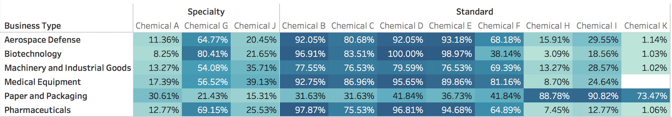
Product Affinity by Segment 1. To understand if there are differences in product preferences among segments, we compare the percentage of customers in each segment who have purchased each product. 2. Chemical H, I, K are purchased by higher percentage of customers in Paper and Packaging than the other segments.

Slide 3
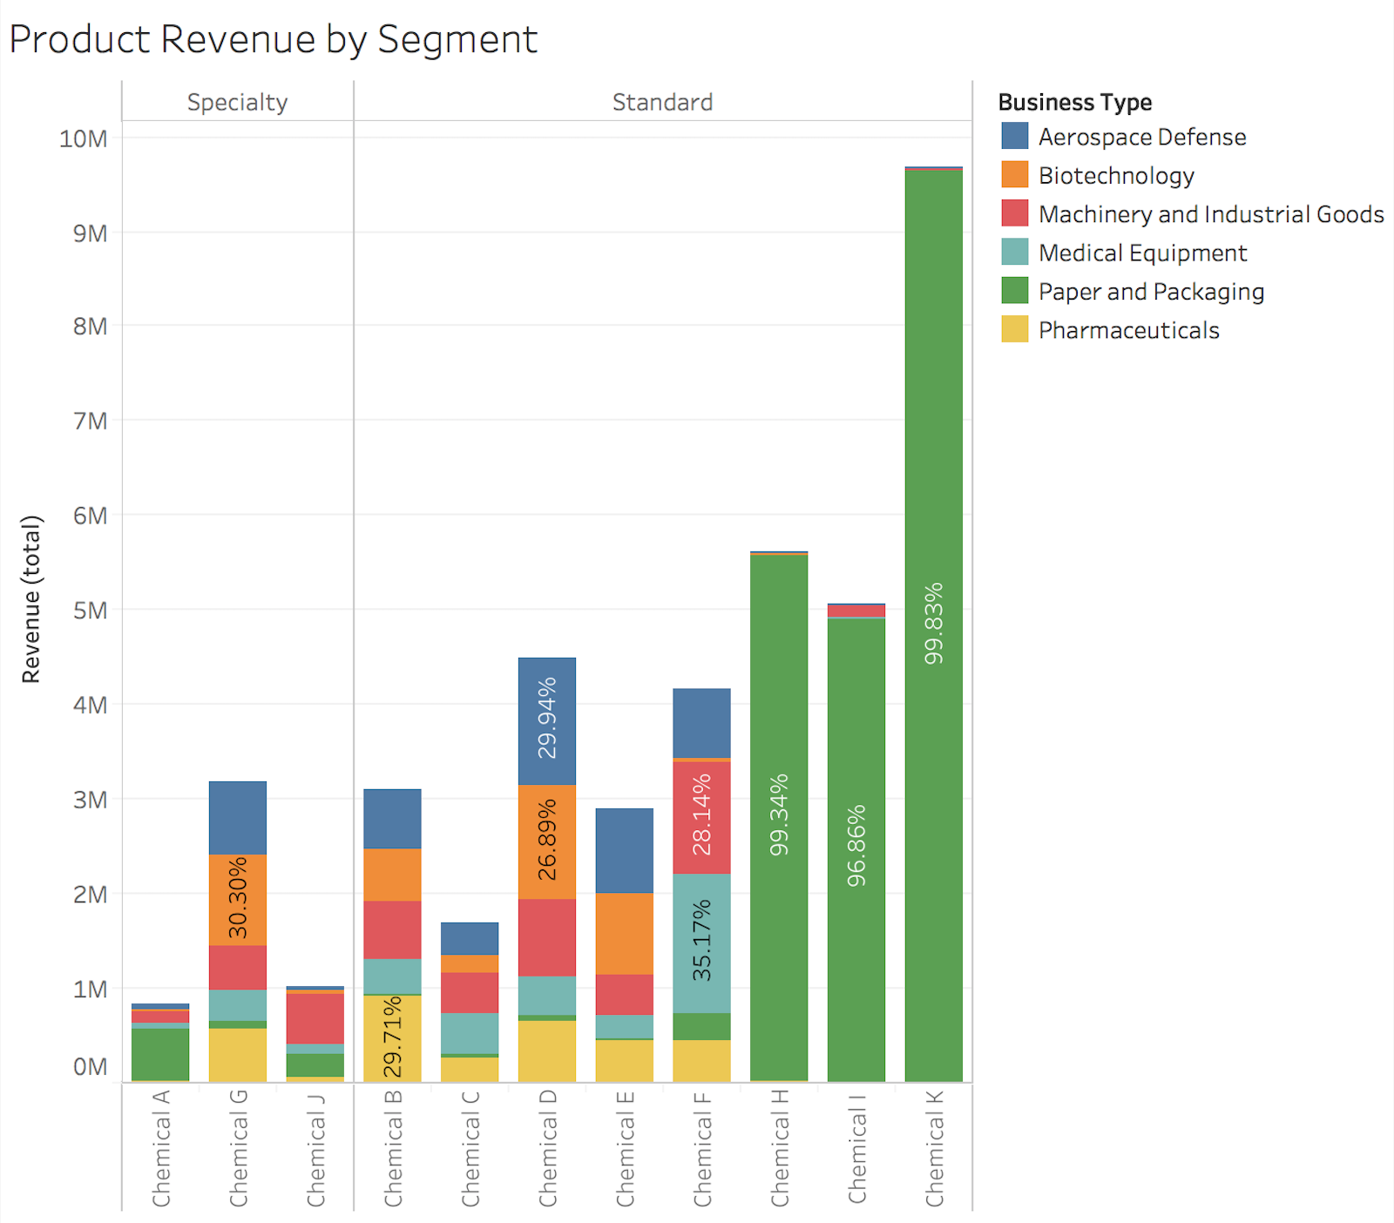
Product Revenue by Segment 1.We can evaluate which segment most effectively contributes to a particular product Revenue by looking at the sales that can be attributed to each product by segment. 2. Paper and Packaging segment contributes the highest to the sales of Product H , I and K

Slide 4
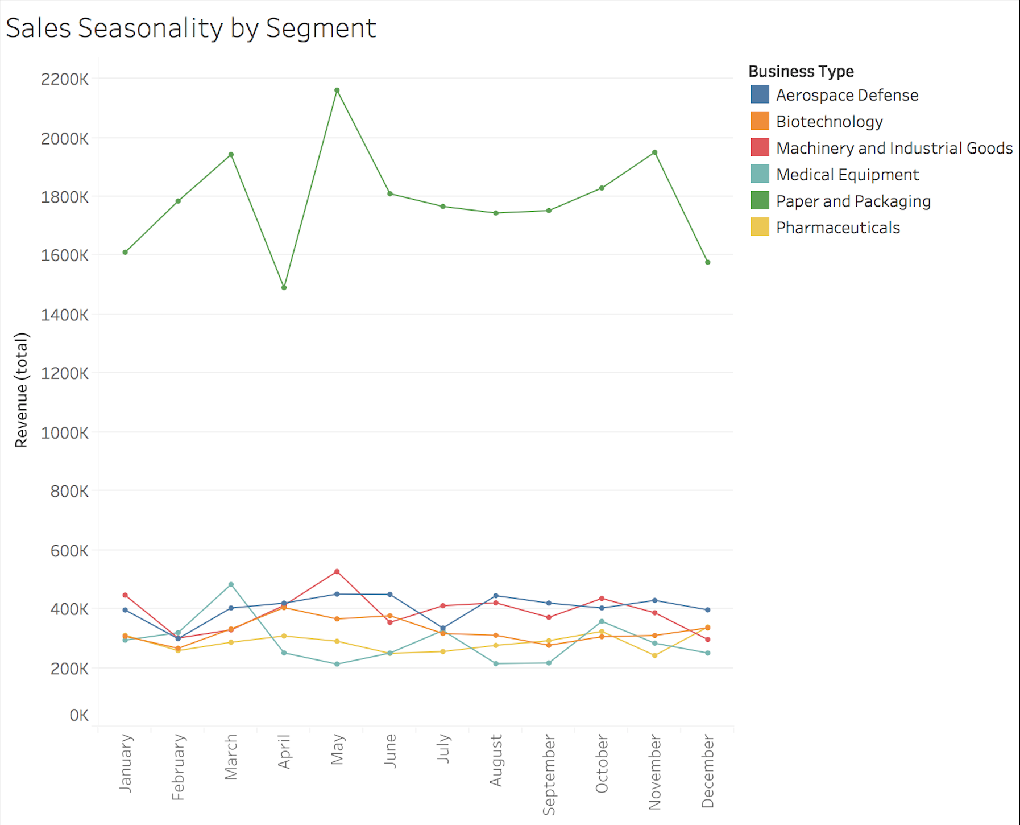
Sales seasonality by segment 1. We can also compare sales seasonality across segments by plotting monthly sales over 2015 in a line chart. 2. Paper and packaging segment has higher sales compared to other segments year round and the sales are highly volatile too.

Slide 5
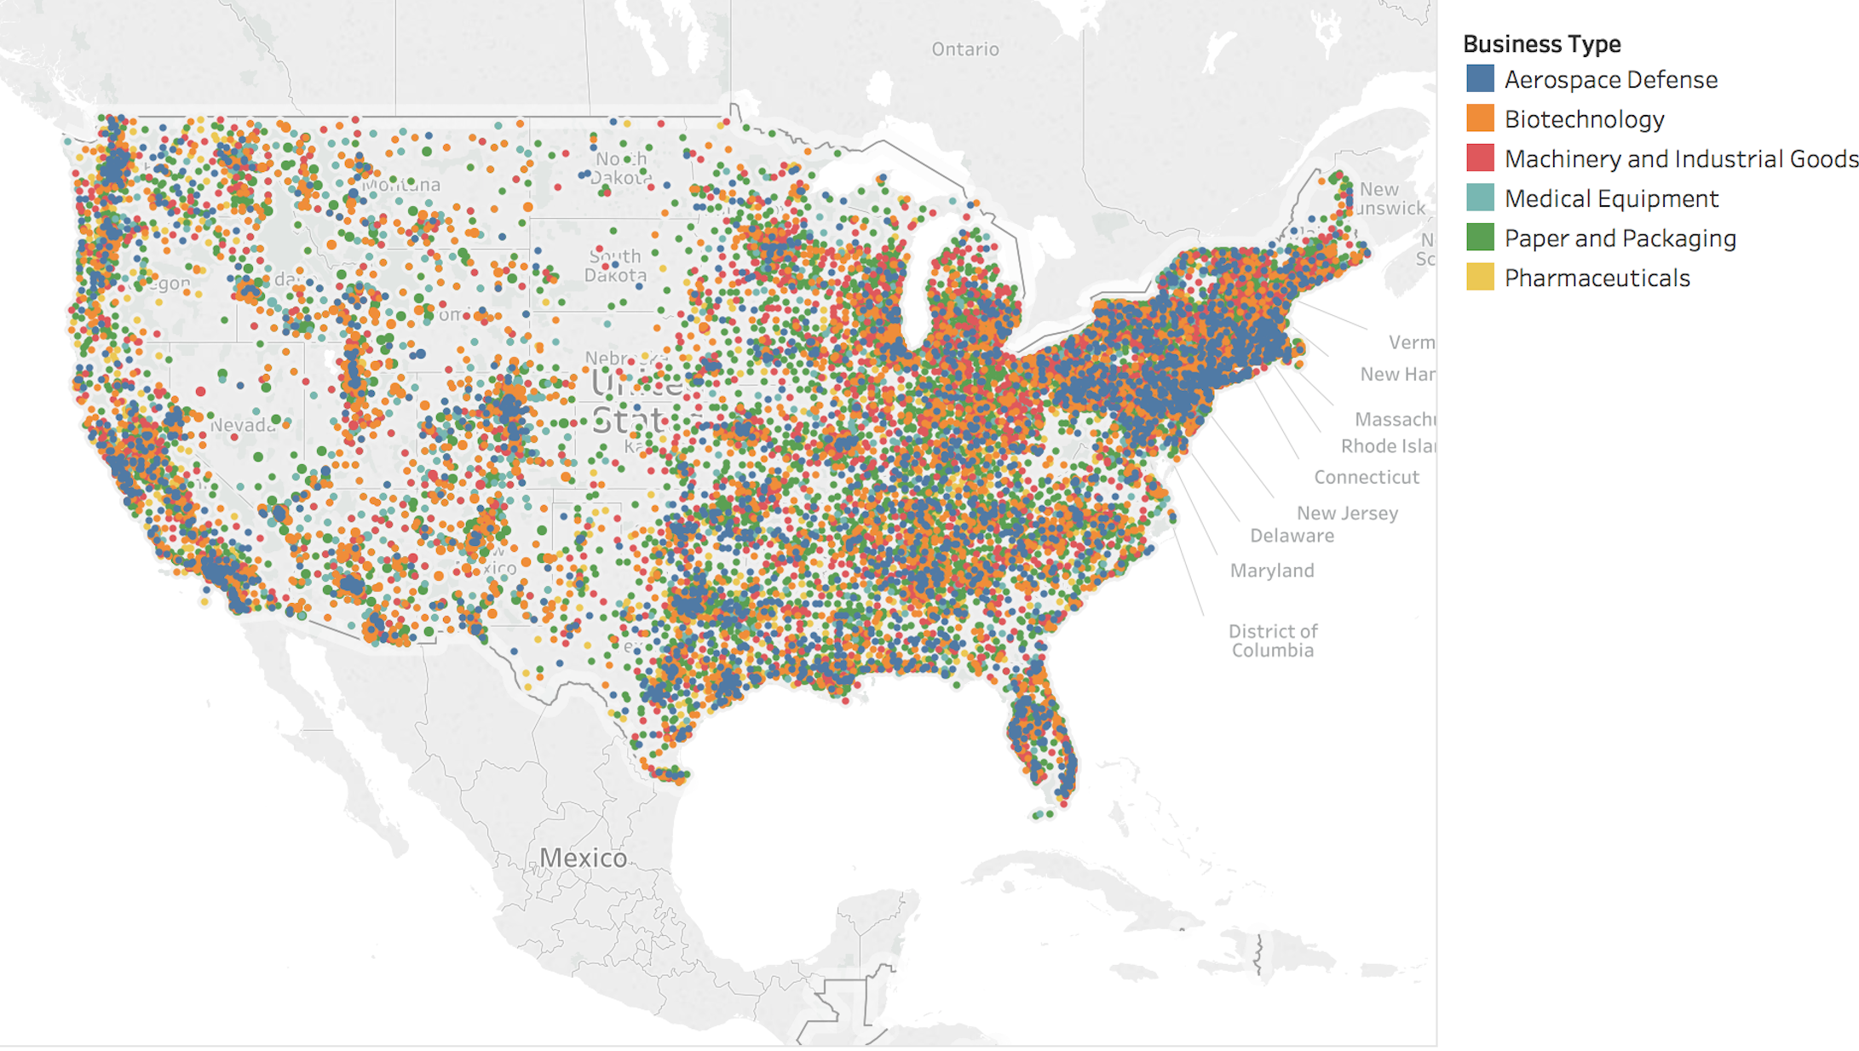
Geographic distribution of segments 1. Since we have zip code data for all sales made, we can map our transactions to understand geographic distribution of customers by segment. 2. The map shows a roughly even distribution of customers for each segment with some concentration of customers in the Aerospace defense in the Northeast and West coasts.

Slide 6
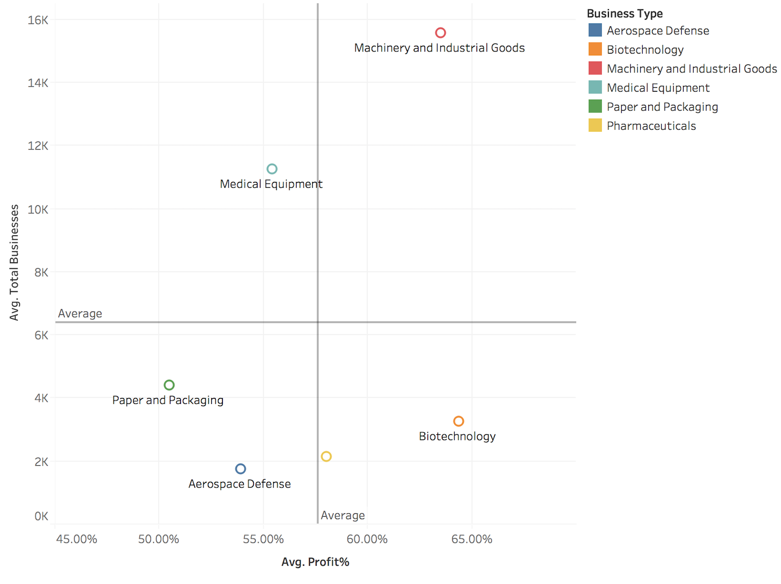
Segment attractiveness matrix 1. We want to target a segment that has higher than average profitability and market opportunity. 2. The only segment that falls in the top right quadrant (above average profitability and above average number of registered businesses) is Machinery and Industrial goods, making it our most attractive segment.

Slide 7
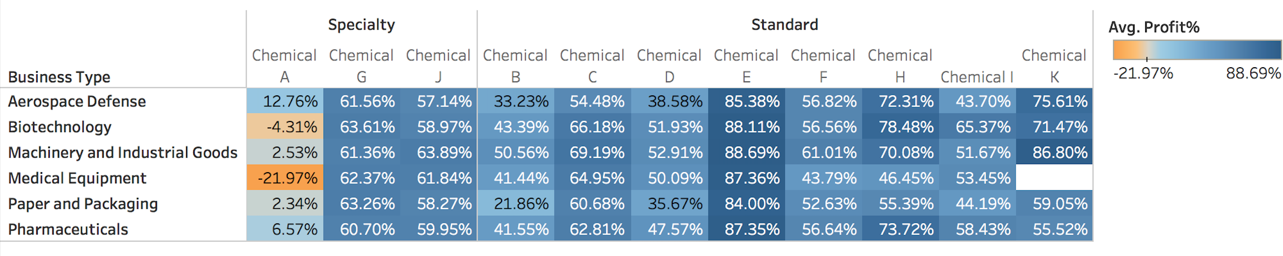
Segment Profitability by Product 1. For the most attractive segment Machinery and Industrial goods ,Chemical E and Chemical K are driving higher profits. We should target our efforts on the manufacture and supply of E and K 2. Seems like Chemical A is driving minimum profit among segments and in some segments leading to loss of money and we should consider discontinuing this product.

